Slide 1
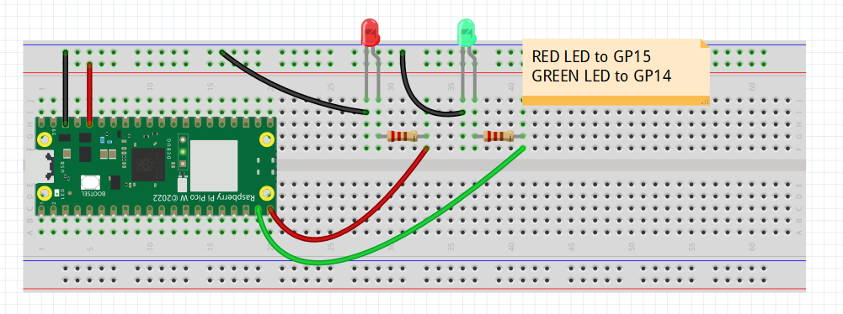
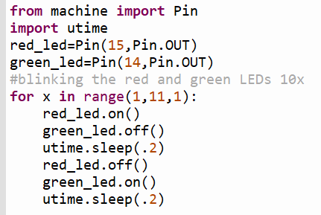
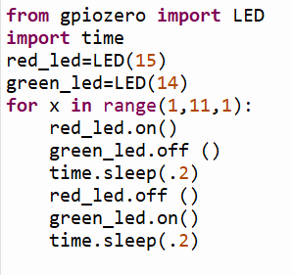
Pico
Rpi

Slide 2
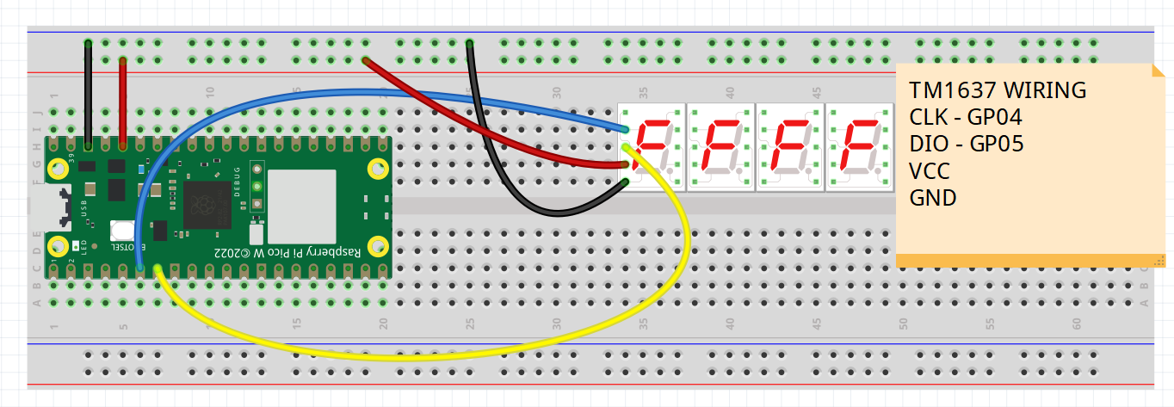
Pico
Rpi
>>> import tm1637
>>> tm = tm1637.TM1637(clk=machine.Pin(4), dio=machine.Pin(5))
>>> tm.show(' ‘)
>>> tm.show(‘HELP’)
>>> tm.number(1)
>>> tm.number(12)
>>> tm.number(123)
>>> tm.number(1234)
>>> import tm1637
>>> display = tm1637.TM1637(4,5)
>>> display.clear()
>>> display.set_values([‘H’,’E’,’L’,’P’])
>>> display.set_values([‘ ‘,’ ‘,’ ‘,’1’])
>>> display.set_values([‘ ‘,’ ‘,’1’,’2’])
>>> display.set_values([‘ ‘,’1‘,’2‘,’3’])
>>> display.set_values([‘ 1,’2‘,’3’,’4’])

Slide 3
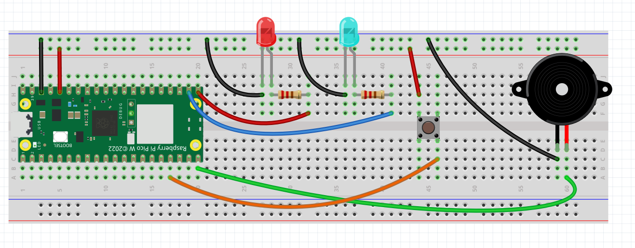
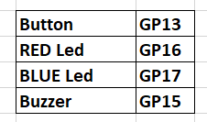
Patrol Car Flashing Lights
PULL_DOWN

Slide 4
ChatGPT Demo
micropython pico w a program with button on Pin 13, red led on Pin 16, blue led on Pin 17 and a buzzer on Pin 15. When button is pressed, flash red and blue led and buzz. use from machine import Pin

